Slide 1
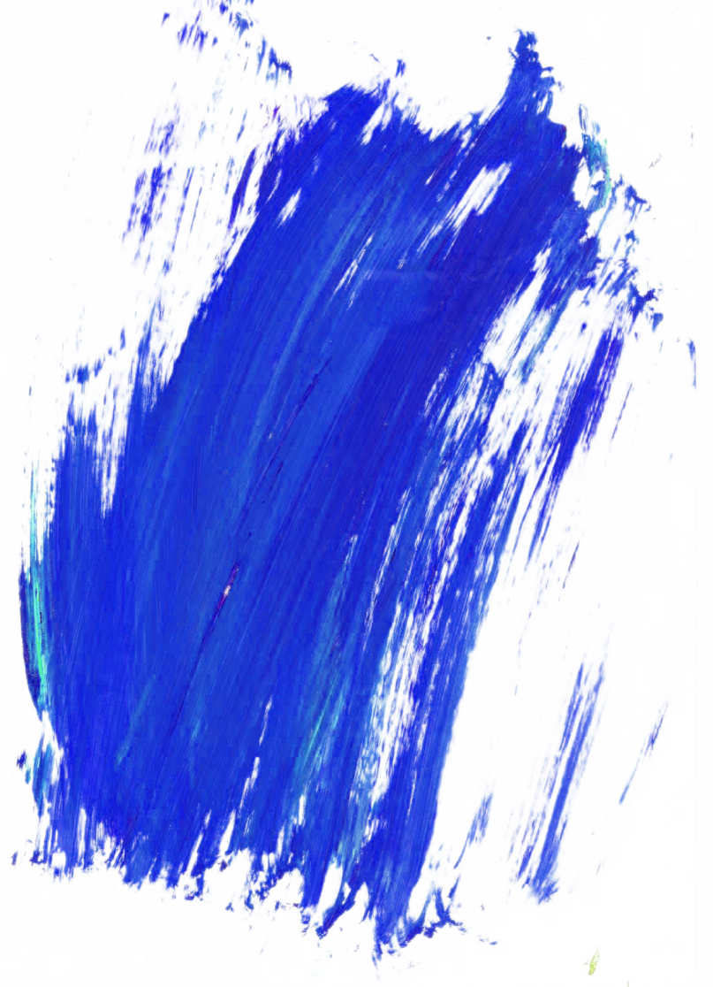
—— 2023
Functions
PART.

Slide 2
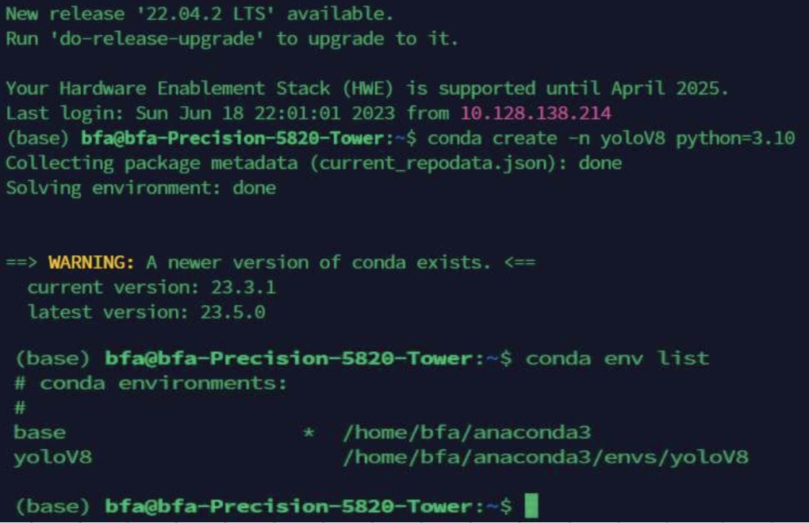
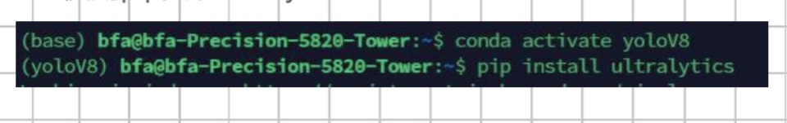
01
Functions
·Collect image samples of the selected 3 items.
·Using samples to train/calibrate obejct detection algorithms
We install and configurate the YOLO V8 to implement this function.

Slide 3
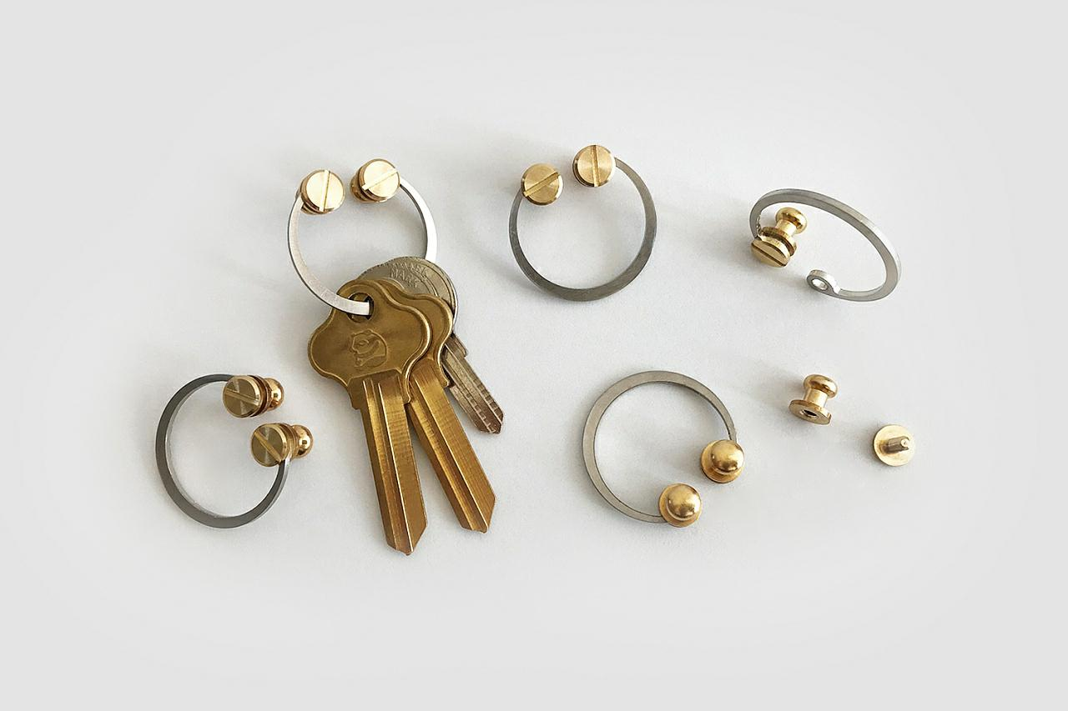
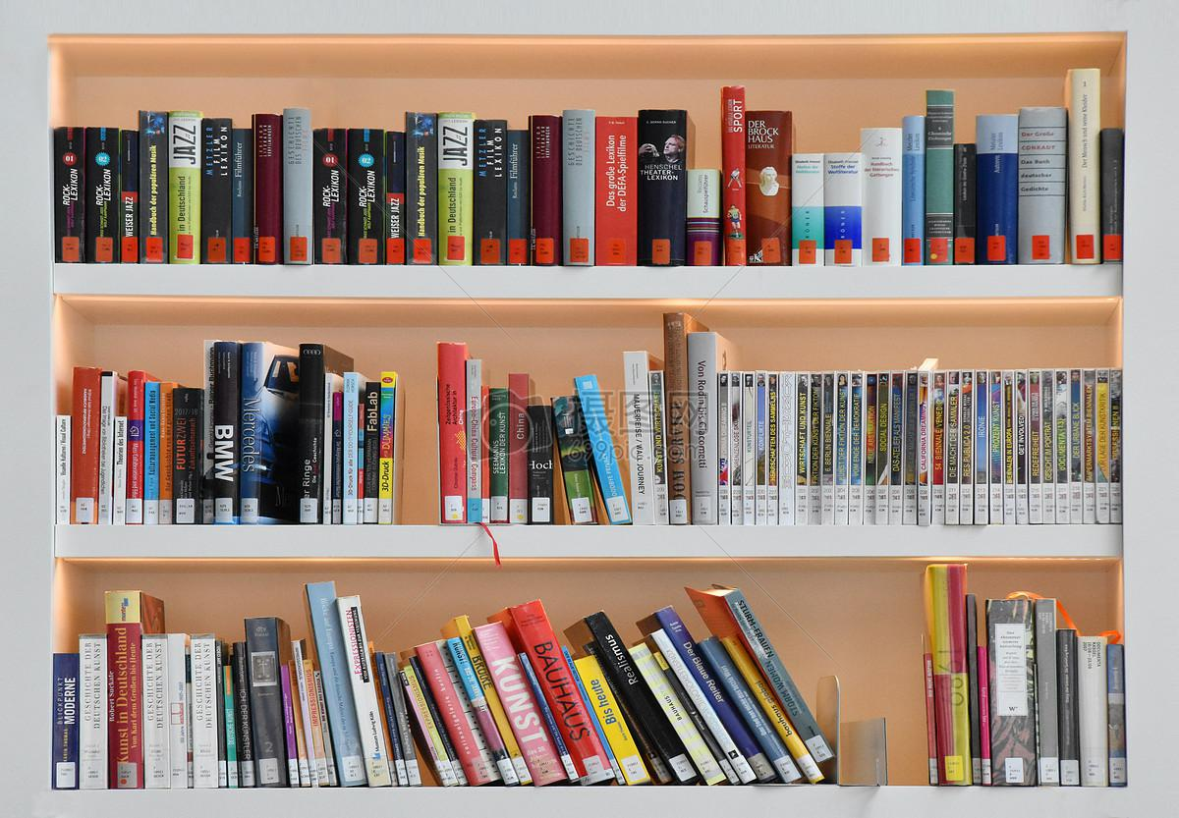
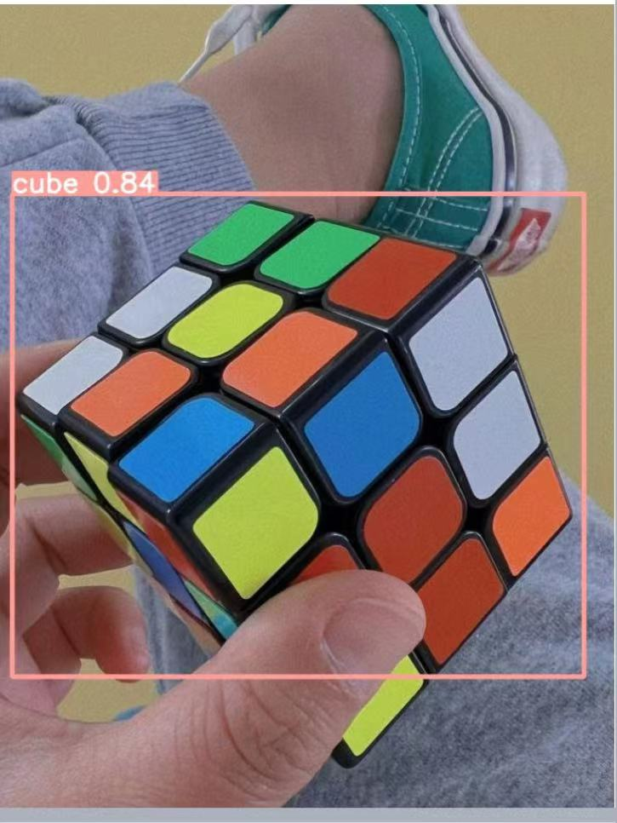
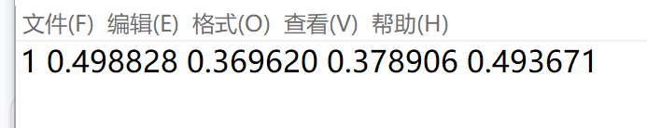
01
Functions
·Collect image samples of the selected 3 items.
·Using samples to train/calibrate obejct detection algorithms
labels
images
Find the dataset and annotate it

Slide 4
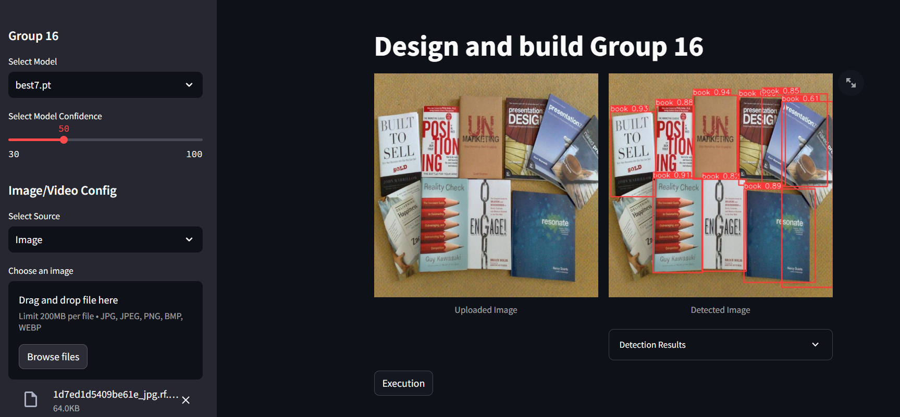
Functions
03
Generate a simple GUI to demonstrate the accuracy of trained algorithms

Slide 5
—— 2023
Technology implementation and development
PART.

Slide 6
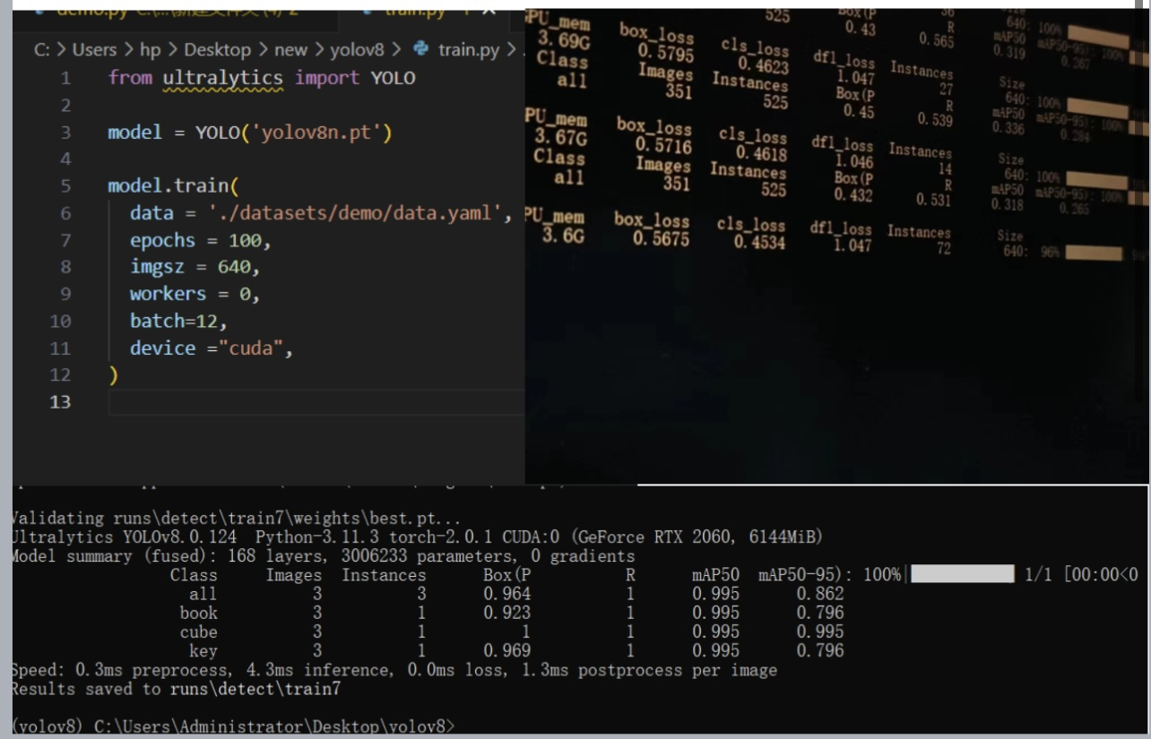
01
train the images by train.py
.

Slide 7
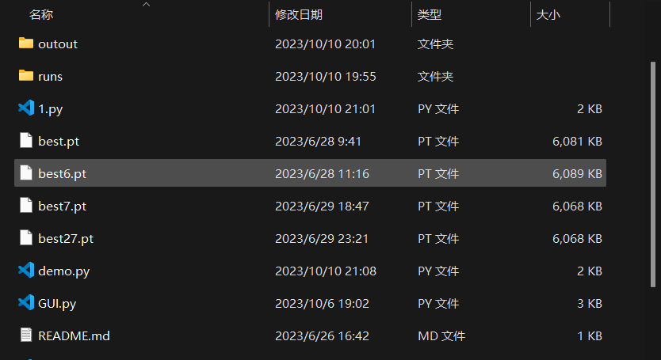
02
get the best model:best.pt
.

Slide 8
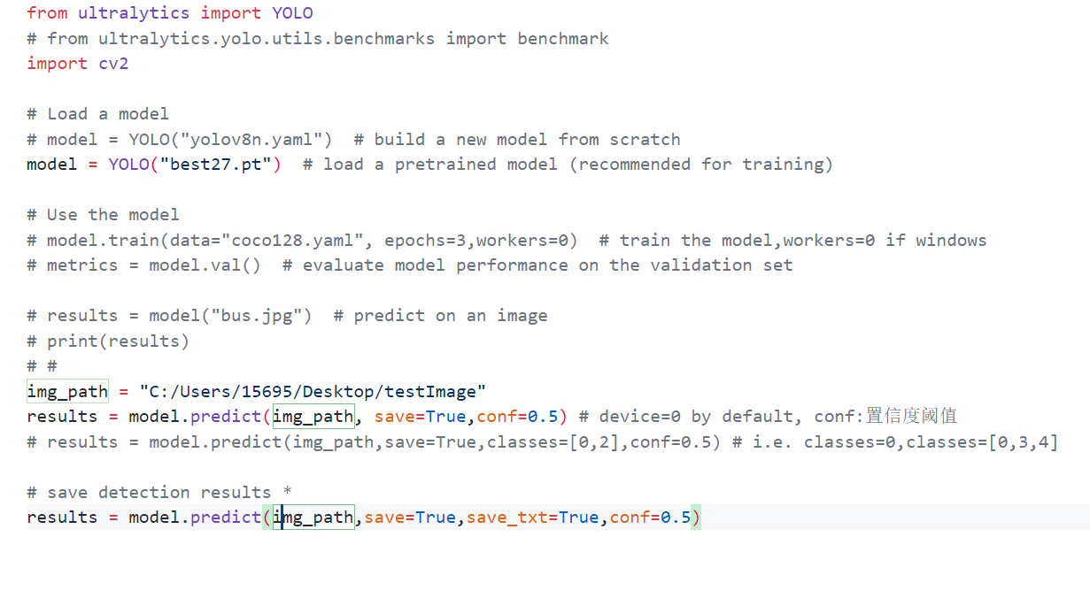
03
use the model best to identify images in demo.py
.

Slide 9
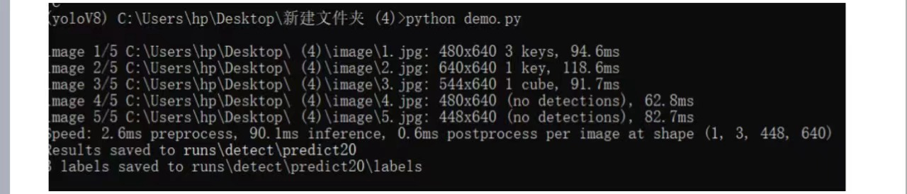
04
run demo.py
.

Slide 10
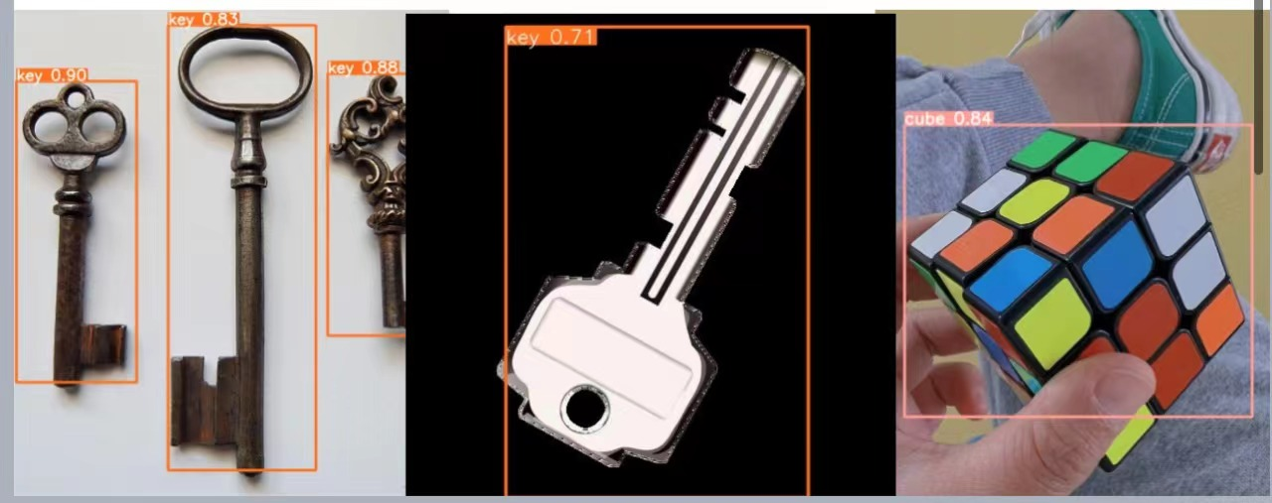
05
get the result
.

Slide 11
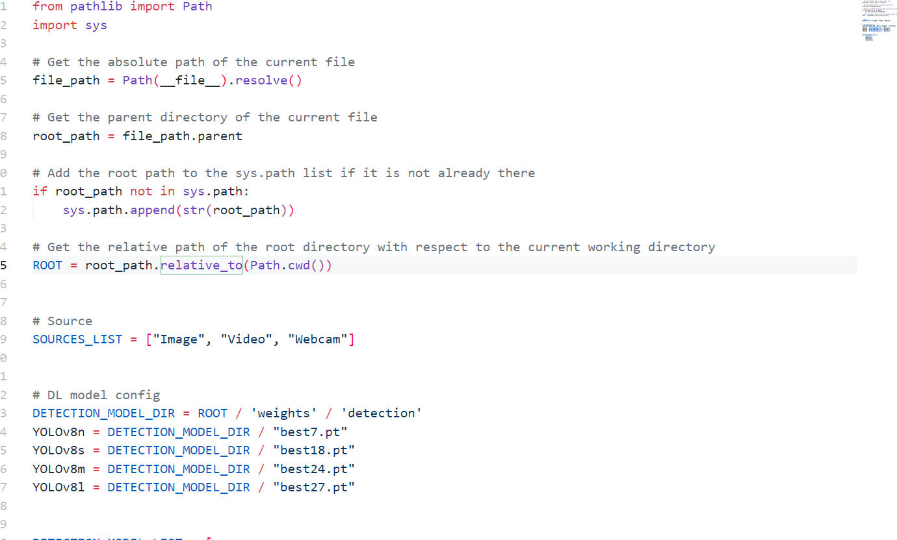
06
Use GUI to verify the accuracy of these images
.

Slide 12
07
send images to a website
.

